Slide 1



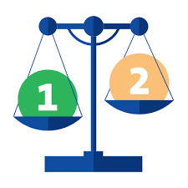
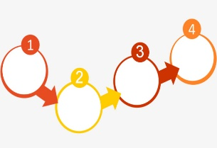

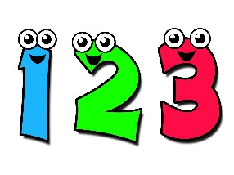

EYFS
Recall
Measure
Recording
Compare
Being a
Mathematician is about…
Ordering
Use vocabulary
Count
Recognise

